Slide 1

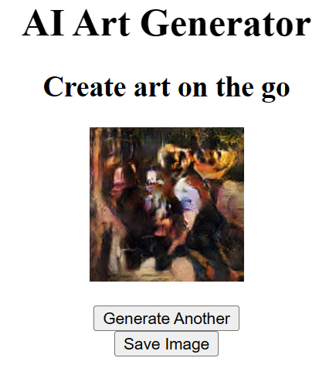
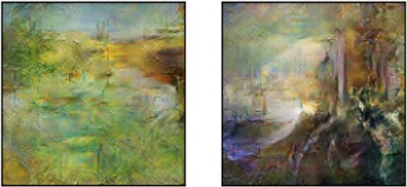
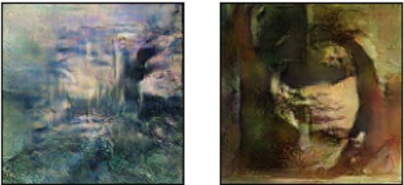
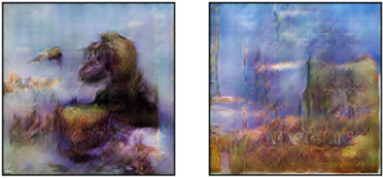
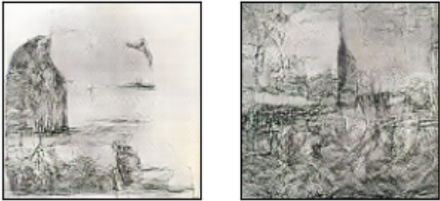
Art Creation Using AI
Name:M.Zaki Al Akkari-K00233639 Supervisor:McKinley Magale
Motivation
Web App Development
Art creation is one of the most challenging tasks and requires lots of time an effort.
Owning a piece of art is hence very expensive.
With the ever-evolving technology of Generative Adversarial Networks, we can deploy AI to generate art on the go.
No much studies in the literature on applying GAN for generating art
I deployed my trained GAN model on a web app that is locally launching.
I used Python flask for my developing my web app due to its ease of use and integration with tensorflow.
Training Method
.
Real art images
Discriminator Loss
Discriminator
Probability
real image
Generator
My we app allow the user to generate a new image or save the current image.
Generator Loss
Results
Conclusion and Future work
The image below show images of the trained GAN after 500 training epochs using Adam optimizer.
I developed and deployed a GAN model trained on over 8,500 art images to generate fine artwork.
The model was evaluated using the FID metric.
For future work, I am planning to deploy the model on cloud services such as AWS.
Also, it would be interesting to use deeper architectures for both generator and discriminator and compare performance.

